Slide 1


CS6004ES – Application Development Coursework 1
London Metropolitan University
Academic Year 2023/24

Slide 2
Coursework Overview
• Individual coursework in C# using Visual Studio 2015 or higher
• Develop and document a small application
• Weight: 30% of module mark
• Submission Deadline: TBC
• In-Class Demo: TBC

Slide 3
Software Development Task
Develop a software application for ABC Car Traders:
Admin functionalities: Manage Cars, Parts, Orders, Customers, Reports
Customer functionalities: Register, Login, Search, Order, Track Order
Must follow Object-Oriented Programming principles

Slide 4
Deliverables
Software project in Visual Studio 2015 or later
- Source code, compiled classes, executable file, data files
Reflective essay (1000+ words) covering:
- Running instructions
- Software architecture (class design)
- Description of properties and methods
- Search algorithm explanation (if applicable)
- Reflection on development experience

Slide 5
Marking Scheme - Implementation (60%)
User Interface Design (15%)
Customer/Admin Login (10%)
Customer Registration (10%)
Admin: Manage Car & Parts Details (20%)
Customer: Search & Order (20%)
Order Tracking & Report Generation (25%)

Slide 6
Marking Scheme - Documentation & Code Style
• Documentation (30%)
- Running Instructions (10%)
- Software Architecture (15%)
- Class Properties & Methods (10%)
- Search Algorithm (10%)
- Reflection (10%)
• Code Clarity & Style (10%)
- Naming conventions, Comments, Validation, UI usability

Slide 7
Next Steps
1. Plan your application design (classes & relationships)
2. Set up the project in Visual Studio
3. Implement features step-by-step
4. Write the reflective documentation
5. Test and prepare for submission before the deadline

Slide 8
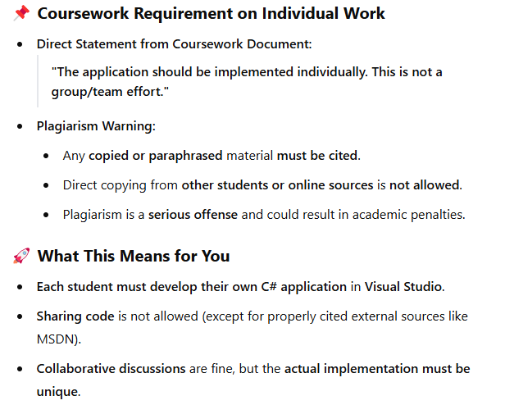
Notes

